Slide 1
Equity Indicators
Site Aims:
1 – Provide rigorous scores that help us measure our progress, including comparisons
2 – Provide Data (quant, some qual) that help us understand what the scores mean (scores are great, but don't help people see what the inequities look like)
3 – Provide stories (personal, organizations, efforts) that connect the indicators to lived experience and solutions

Slide 2

Homepage – Equity Indicators
Housing | Education | Economy
Justice | Transportation | Health/Mental Health
Environment | Arts | Social Capital & Civic Access
Alksjf';lskf;aslkfa;slfka;lsdf
F;asfaslkf;askfa;'sklfasfsf
A;slkasdf
Alksjf';lskf;aslkfa;slfka;lsakjsd'falksdjfasfkasfdasf;sfdaksdflksfdlskdjfalsjdfasljfalksfasfj'asfkasljfa;'slfka;skfa;lskf;laskfd;askf;laskfdsfasjdflaksjf;lkasjflaksjfklajsdflkajsdflkajsldfkjasldfjsalkfjsfjalskjfdalskdjfalskdjfalskjdfalksdjfaklsdjfalksdjfalksdjfalksjdflkasjdflkasjfdlasjfdlaksjf;laksjfdlkasjfdlkajsflkjsldfjaslkdfjasklfdjsdf
F;asfaslkf;askfa;'sklfasfsf
A;slkasdf
UNC Charlotte Urban Institute & urbanCORE
Notes:
Home Page –
Shows all the categories;
Doesn't need to stay in this design or these colors (or original donut chart)
Very brief copy about what this is an why it matters, interconnected nature of areas
Maybe a note or popup about using this site
Link to methodology
Link to UNC Charlotte Urban Institute & urbanCORE ("powered by UNC Charlotte Urban Institute & the urbanCORE"), link to contributors on Urban Institute website
Contact email to get involved
If we ever get sponsors, sponsor logos

Slide 3

Housing Homepage
HOMEOWNERSHIP
Succinct copy – why housing is important for individual/community wellbeing
HOMEOWNER
COST BURDEN
Dreamkey Partners & Self-Help Credit Union – increasing BIPOC Homeownership
Promising solution (ideally in Charlotte)
Lived Experience – quote(s) or link to profile – "the rent eats firsts"
RENTAL
COST BURDEN
HOMELESSNESS
Notes:
Each equity area landing page shows a dial with equity scores for each area – each dial leads to another page data that help people understand the score
Each dial possibly to include pop up of scores/trends over time? Or perhaps this is on the specific dial page
Brief copy around why housing/each area is important for individual and community wellbeing
Page also incorporates quotes or profiles in lived experience (with careful framing here – see Frameworks Institue (https://www.epicpeople.org/3-narratives-that-stymie-social-change/) – could link to page with rotating or previously highlighted individuals, families?
Page Highlights a solution – ideally locally – Could link to a page with rotating or previously highlighted solutions

Slide 4

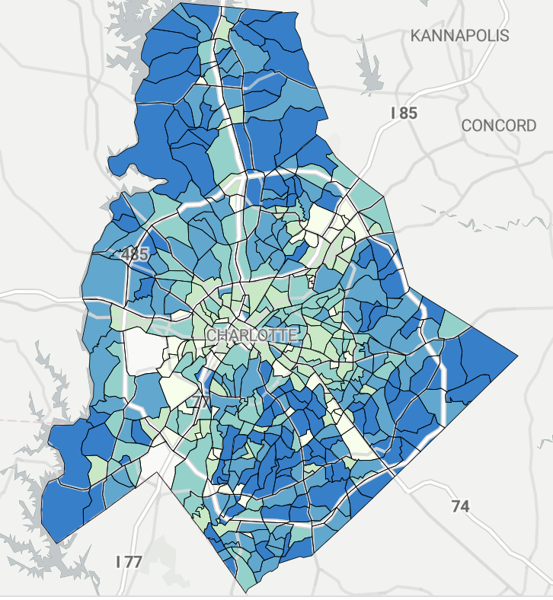
Homeownership Homepage
HOMEOWNERSHIP
Brief description
Why it Matters
Data Source
Brief description
Why it Matters
Data Source
HOMEOWNER
COST BURDEN
Homeownership by race
Homeownership by geography
RENTAL
COST BURDEN
Brief description
Why it Matters
Data Source
Brief description
Why it Matters
Data Source
Home loan denial by geography
Home loan Denial by race
HOMELESSNESS
Notes:
Each dial landing page shows a handful of data points that help the reader understand the nature of that score, including the underlying data (i.e, bar chart of homeownership rates), other illustrative data points, and spatial nature of equity/inequity
Each data point should include brief interpretive description, why it matters, and source of data
These are only examples that some other communities are using
Could also incorporate regular survey data (i.e., this will likely be necessary for some areas)

Slide 5
Other things to consider:
Likely need an RFP for a designer to do this work (rfp could be open to faculty or students)
UI students can be collecting and prepping data
Community engagement focus on the reactions to the general design, data elements, and framing but also generating the individual/community stories and solutions info; can also reengage research team in Spring
Conveying the interconnectedness of the equity areas (could be highlighted in lived experience stories and solutions, as well as brief writeups of each areas)
Expanding this beyond Mecklenburg County to the Region? Does the homepage become a regional landing page

